Slide 1
StoryTelling
Beginning, middle and end

Slide 2
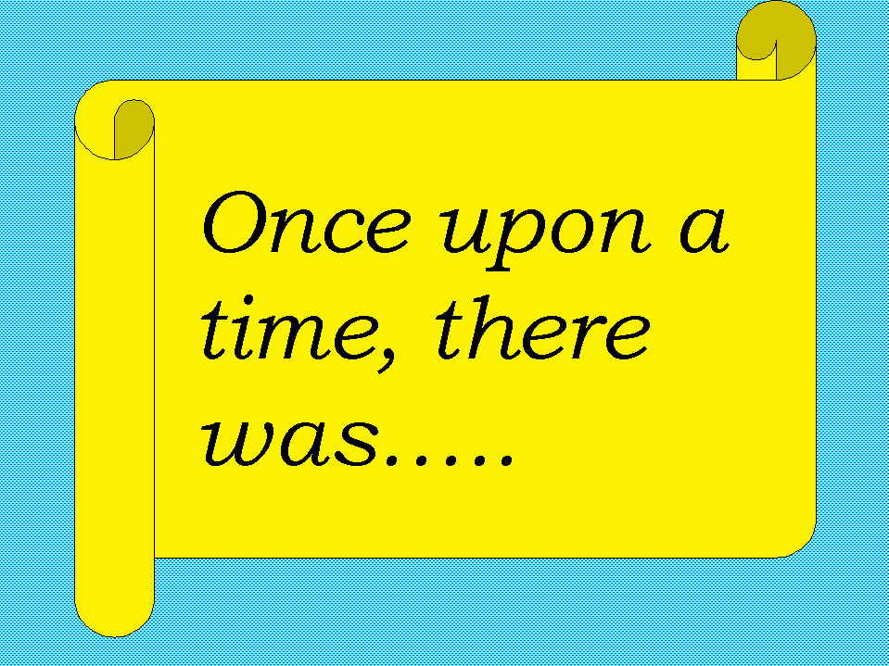
Today
Watch a video about “beginning, middle and end.”
Go over story telling time words
Work in groups to put a story in order
Make a fun story as a class!

Slide 3
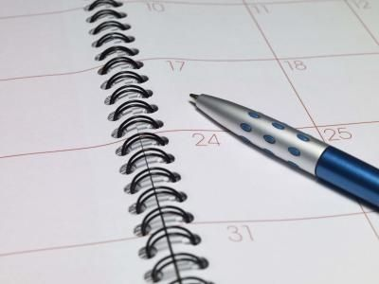
STORYTELLING WORDS – Beginning
A few days ago
Last…
Once upon a time

Slide 4
STORYTELLING TIME WORDS – Middle
1. Before
2. Then
3. After
4. Later
5. One day

Slide 5
STORYTELLING TIME WORDS - End
Now
Right now
Today

Slide 6
So maybe your story is…
Last month I went to the USA
One day I went to Hollywood.
Before lunch, I went shopping.
Then I saw a movie.
After, I ate dinner.
Now I am in Korea again.

Slide 7
Now it is time for you to make your story!

Slide 8
You will…
Take the papers
Put the papers in order
Glue them in order on the sheets under the box
Draw a picture in the box.

Slide 9
Your story (hints):
Fantasy
Once upon a time…
But…
… said the Queen.
A musician came…
One day, a teacher…
He came with…
One day…
The queen heard…
Now…
Horror
Last week…
Yesterday…
Where am I going?
Don’t touch…
Later…
What did I do with the wolves?
It’s too late?
I shouted…
Now…

Slide 10
Let’s make a story!
http://learnenglishkids.britishcouncil.org/en/make-your-own/story-maker

